Slide 1
Pension Made Easy
Claims Office Productions

Slide 2
Pension Forms & Terms
The Claim forms: Veteran - VA Form 21-527ez and Dependents – VA Form 21-534ez
Supporting forms: VA Form 21-0969 For reporting Income, Interest, etc.
VA Form 21-0779: reporting nursing home status
VA Form 21-2680: reporting the need for aid and attendance, housebound
VA Form 21-8416: reporting medical expenses, also used for UME each year
EVR Forms for reporting income – VA Form 21-0516-1 through 21-0519-1
There are a few more forms, but they are not commonly used - for example, farm income, etc.

Slide 3
Common Terms Used in Pension
NSC Pension (Non-Service Connected)
NSC Disability
Aid and Attendance
Housebound
Base Rate
Medical Expenses
UME (Unreimbursed Medical Expenses)
CES (Care Expense Statement)
Income for VA purposes
Countable Income
RMD (Required Monthly Distributions)
Interest Income

Slide 4
Terms Continued
Assets
Net Worth: is the sum of a claimant’s or beneficiary’s assets and annual income. You should report all of your net worth. For purposes of entitlement to a VA pension, the net worth limit effective December 1, 2024, is $159,240.
Surviving Spouse
Disabled Veteran over 65 or 100% for NSC
Irrevocable Trusts
Irrevocable Burial Trusts
UME Offset Explained
3-Year Lookback/ Penalty period
MAPR: Maximum Annual Pension Rate
Liberalizing Legislation (pension could go back one year)

Slide 5
Eligibility Periods
War Time Veterans Under current law, VA recognizes the following wartime periods to determine eligibility for VA Pension benefits:
Mexican Border Period (May 9, 1916 – April 5, 1917, for Veterans who served in Mexico, on its borders, or adjacent waters)
World War I (April 6, 1917 – November 11, 1918)
World War II (December 7, 1941 – December 31, 1946)
Korean conflict (June 27, 1950 – January 31, 1955)
Vietnam era (February 28, 1961 – May 7, 1975, for Veterans who served in the Republic of Vietnam during that period; otherwise, August 5, 1964 – May 7, 1975)
Gulf War (August 2, 1990 – through a future date to be set by law or Presidential Proclamation)

Slide 6
UME Off Set Explained
Think of the UME offset kind of like copays. It is calculated by multiplying the annual pension rate by 5%
Base pension rate $1413 x .05=848
Base Pension rate with 1 dependent $22216 x .05= $1102

Slide 7
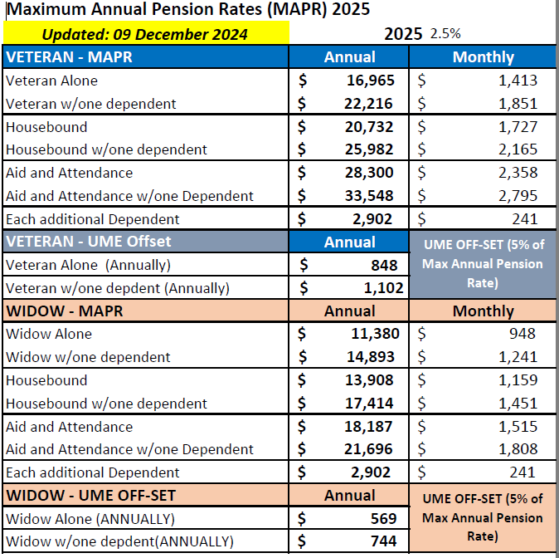
Maximum Annual Pension Rates (2025)

Slide 8
Example of Calculating UME Off Set
If your medical expenses for a year are $8,000 and your medical insurance pays $6,400 of that, your unreimbursed medical expense is $1,600.
That portion of your unreimbursed medical expenses ($1,600 in the example above), which is more than 5% of the maximum rate of pension, or $848 in this example ($16965 x .05 = $848), may be deducted from your total combined income which then increases the amount VA will pay to you.
Since the $1,600 out-of-pocket expenses are greater than $848, you may reduce your family income by $752($1,600 - $848). So, your income for VA pension purposes is now $10103 ($10,855 - $752).
Your VA pension rate would then be $16965(maximum rate for a veteran) minus $10103 (total family income after deducting unreimbursed medical expenses), or $6862 for that year.

Slide 9
Math (The Scary Part)
Pension is a program that attempts to keep the veteran or dependents above the poverty line.
The Math is elementary if you think about it.
For a brand-new claim, it is income minus ongoing medical expenses. It’s that simple.
Now it starts getting complicated when the veteran has other assets that could make them over the asset guidelines.
As of this class, the VA considers $159,240 in assets to be over the limit for the VA pension.
But there are always exceptions to this rule. For example, they have $20k per month in Nursing home fees, the VA may still grant the pension.

Slide 10
Math Examples
Veteran # 1 is not married and has no dependents. He was a farmer and did not pay into Social Security. So, he has no income and is over the age of 65, and uses the VA for all his health care and does not have Medicare. He lives at home and is healthy. He is a wartime veteran, which makes it easy.
How much will he get?

Slide 11
Math Examples
Veteran # 1 would get the base rate for a single veteran.
$16,965 Yearly
$1,413 monthly

Slide 12
Math Examples
Veteran # 2 is not married and has no dependents. He is 54 years old, has no income, and no medical expenses; he gets all his care at the VA. (What else do we need to know?)
How much will he get?

Slide 13
Scenario
Veteran # 2 could possibly be eligible if the VA determines he is 100% due to NSC disabilities and a wartime Veteran
$16,965 Yearly
$1,413 Monthly

Slide 14
Math Examples
Veteran # 3 is 80 years old, married, with no other dependents. He served from Aug 1950 to September 1951
Social Security income = $1,078 for self and $488 for wife
Medical Expenses = $370 Medicare for himself and spouse per month
Etna Supplemental = $348 per month for himself and spouse
Part D = $70 per month for him self and spouse
How much will he get?

Slide 15
Math Examples
Veteran # 3
Income of $1,566 per month $18,792 per year
Med. expense $788 per month $9,456 per year minus UME $1102
Med. expense after UME $8354 $18,792 - $8,354 = $10438
Income after Med expenses $10,438- Vet W/1 dependent $22,216 base =$11,778 annual
Amount of Pension $981 per month

Slide 16
Math Examples
Veteran # 4 is 69 years old, married, with no other dependents. He served from Aug 1, 59-Feb 27, 1961
Social Security income = $1,000 for self and $488 wife
Medical Expenses = $280 Medicare for himself and spouse per month
Etna Supplemental = $400 per month for himself and spouse
Part D = $160/per month for him self and spouse
How much will he get?

Slide 17
Math Examples
Veteran #4 is not Eligible he is not a war time veteran.

Slide 18
Math Examples
Veteran # 5 is 80 years old, married, with no other dependents. He is in a nursing home. He served from August 1950 to September 1951.
Social Security income = $1,078 for self and $488 for wife
State Bank RMD = $500 per month $50,000 in value for wife
State Bank RMD = $1,500 per month $50,000 for veteran
Irrevocable Funeral trust value of $20,000
Money in bank = $30,000
Nursing home expenses for Veteran= $8,000 per month
Medical Expenses = $370 Medicare for himself and spouse per month
Etna Supplemental=$348 per month for himself and spouse
Part D = $70 per month for him self and spouse

Slide 19
Math Examples
Veteran # 5
Income = $42,792
Med expense after UME $10,4354
$2,795 Max rate

Slide 20
Questions

